Slide 1
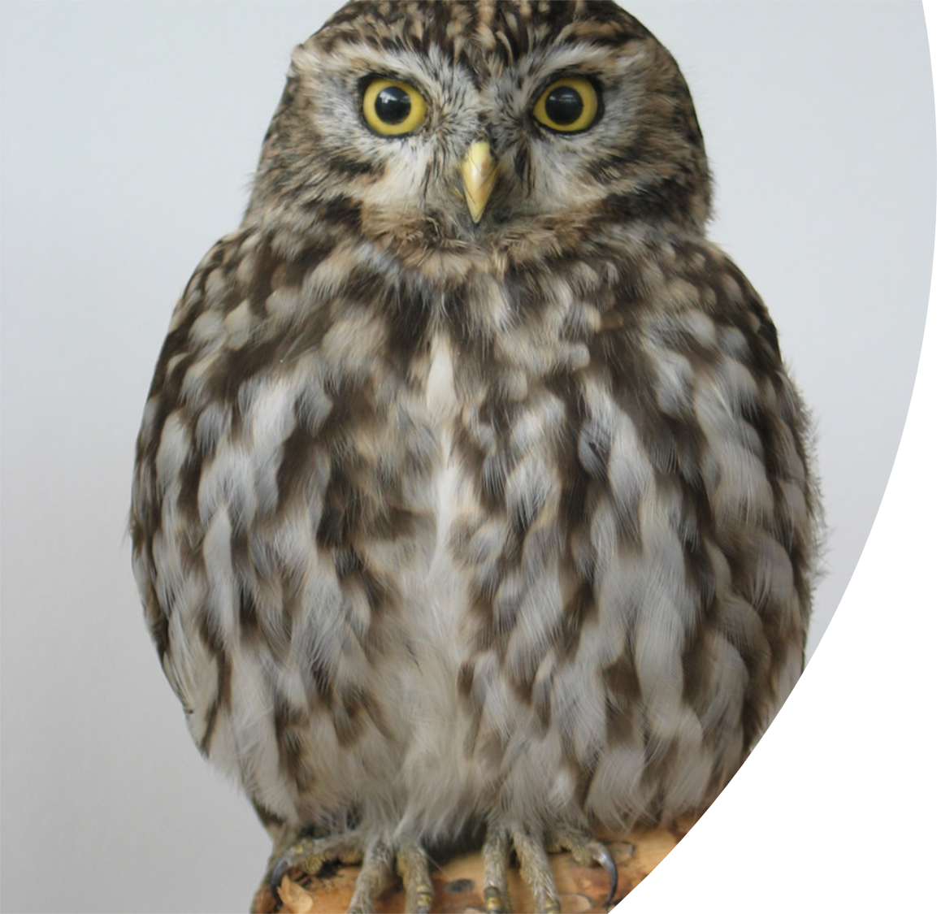
James 4: 11-17
More wisdom

Slide 2
But He gives more grace.
Therefore He says,
“God resists the proud, But gives grace to the humble.”
(James 4:6)

Slide 3
Two matters – same problem
1. Judging
2. Boasting

Slide 4
Do not speak evil of one another, brethren.
(James 4:11)

Slide 5
The Heart
The Heart
The Heart
What is in your heart?

Slide 6
1. You are JUDGING your brother or sister
2. You are JUDGING God’s law

Slide 7
1. You are JUDGING your brother or sister
With what judgment you judge, you will be judged.
(Matthew 7:2)
Who are you to judge another's servant?
(Romans 14:4)

Slide 8
2. You are JUDGING God’s law
You shall love your neighbour as yourself.
(Leviticus 19:18)
A new commandment I give to you, that you love one another.
(John 13:34)

Slide 9
A judge of the law
God’s Law
A doer of the law…

Slide 10
The Heart

Slide 11
Two matters – same problem
1. Judging
2. Boasting

Slide 12
“Today or tomorrow we will go…
and spend a year…
and make a profit…”
$ $ $

Slide 13
But God said to him, “Fool”
So is he who lays up treasure for himself, and is not rich toward God.
(Luke 12:21)

Slide 14
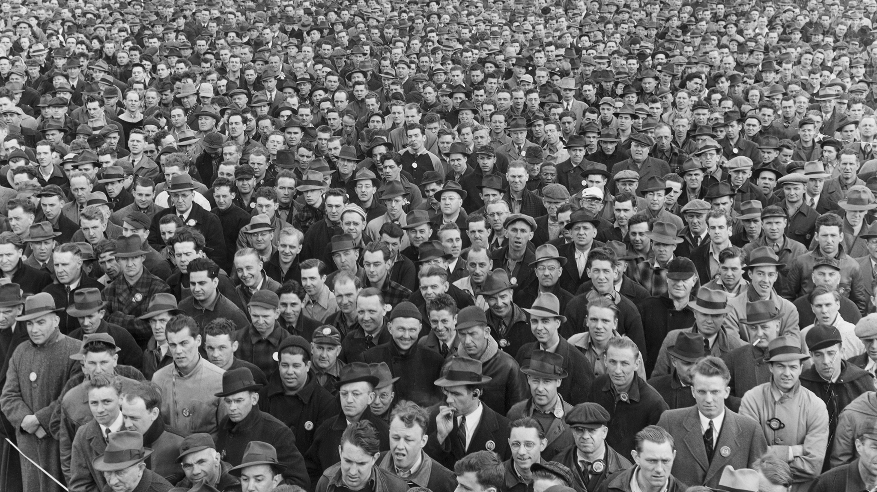
Where are they now?

Slide 15
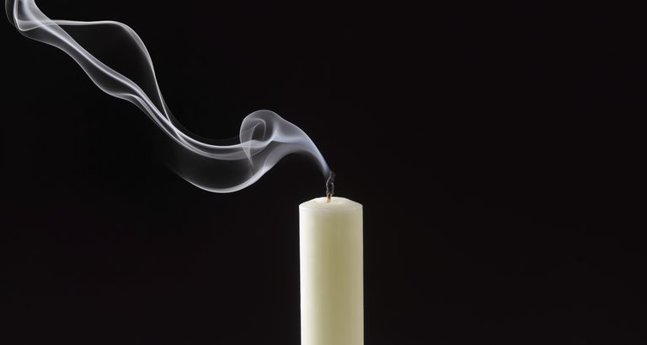
What is your life?

Slide 16
If the Lord wills, we shall live and do this or that…
The Lord is my shepherd…
(Psalm 23:1)

Slide 17
Therefore, to him who knows to do good and does not do it, to him it is sin.
(James 4:17)
Why?

Slide 18
The Heart
Keep your heart with all diligence, For out of it spring the issues of life.
(Proverbs 4:23)

